Slide 1
6CS005 High Performance Computing
Tutorial 7 More OpenMP

Slide 2
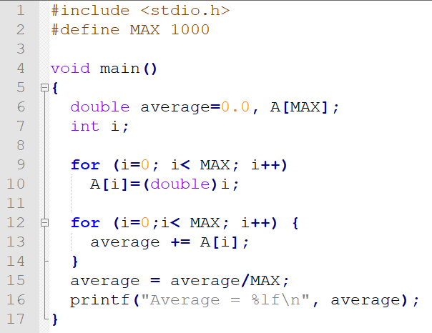

Averaging Program

Slide 3
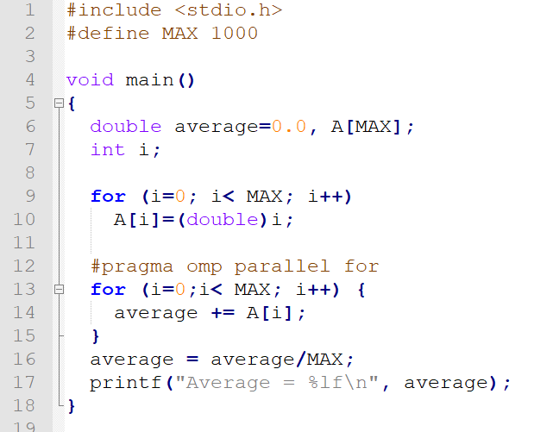

OpenMP Averaging Program

Slide 4
What happen?
Each thread tries to update the shared variable average at the same time creating a race condition
Can be solved with a critical section but this slows down the execution
Faster solution is for each thread to create it's own copy of the variable average and then combine them all at the end
This is called reduction

Slide 5
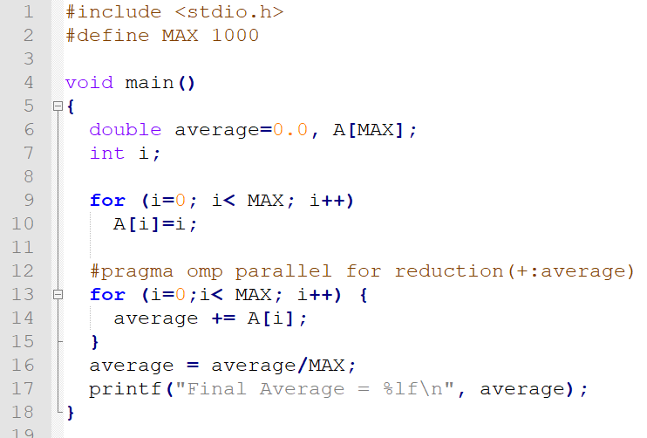

OpenMP Reduction

Slide 6
OpenMP Reduction
OpenMP reduction clause:
reduction (op : list)
Inside a parallel or a work-sharing construct:
A local copy of each list variable is made and initialized depending on the “op” (e.g. 0 for “+”).
Updates occur on the local copy.
Local copies are reduced into a single value and combined with the original global value.

Slide 7
OpenMP: Reduction operands/initial-values
Many different associative operands can be used with reduction - Initial values are the ones that make sense mathematically.
Operator | Initial value
+ | 0
* | 1
- | 0
min | Largest pos. number
max | Most neg. number
& | ~0
| | 0
^ | 0
&& | 1
|| | 0

Slide 8
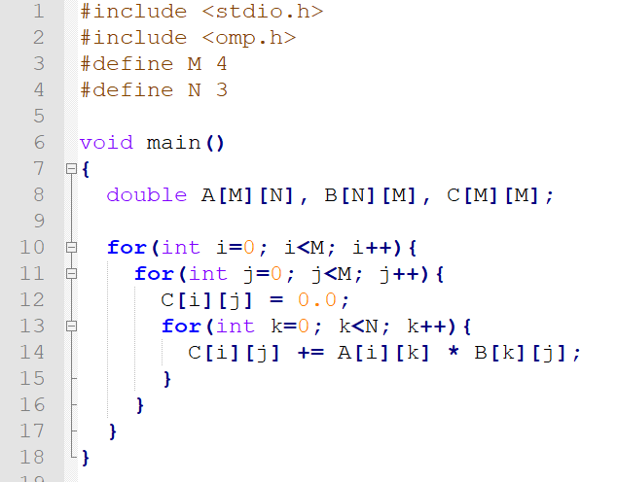
Matrix Multiplication

Slide 9
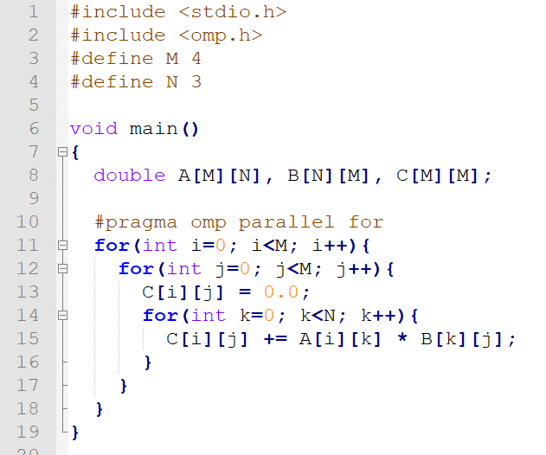
OpenMP Parallel For
Limited by size of loop

Slide 10
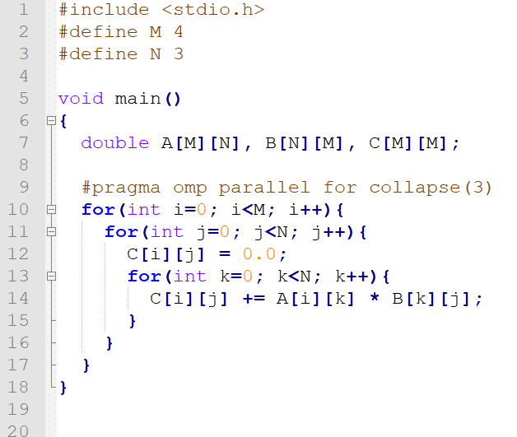
Collapsing loops in OpenMP
Collapse the 3 loops into one internally
M

Slide 11
OpenMP Simple Locks
Directly comparable to pthread mutexes:
omp_lock_t represents a simple lock type
omp_init_lock() initializes a simple lock
omp_set_lock() waits until a simple lock is available and then sets it
omp_unset_lock() unsets a simple lock
omp_destroy_lock() uninitialized a simple lock
omp_test_lock() tests a simple lock and sets it if it is available

Slide 12
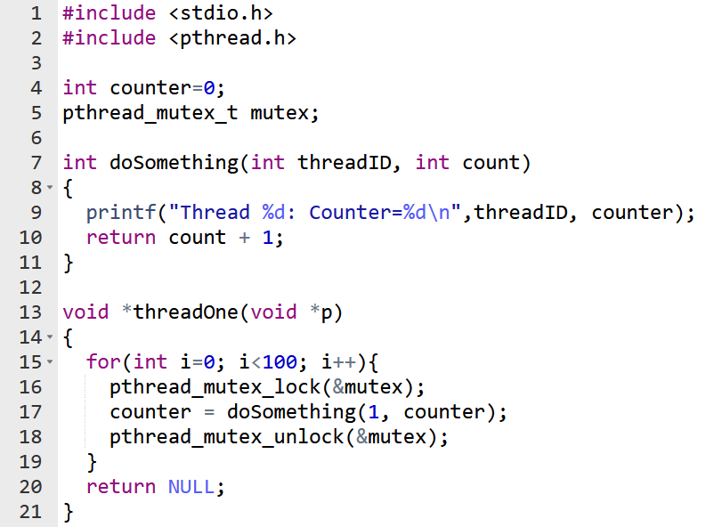
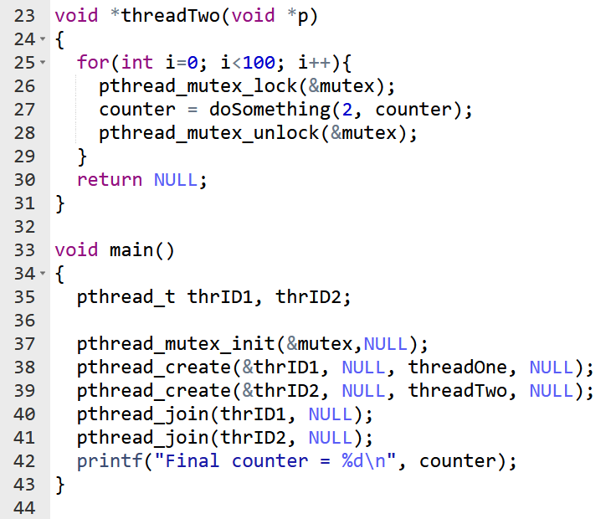
Pthread Mutex

Slide 13
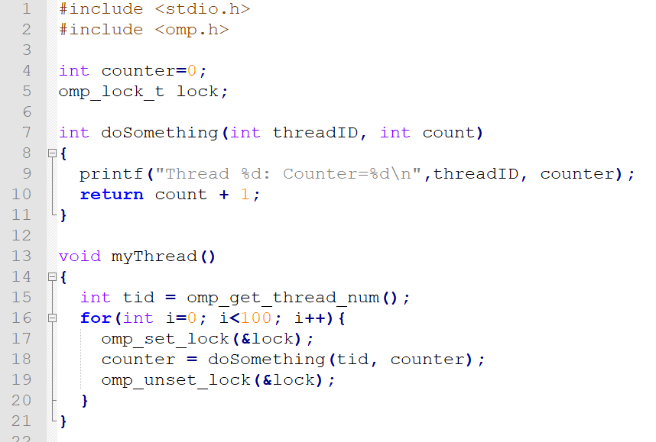
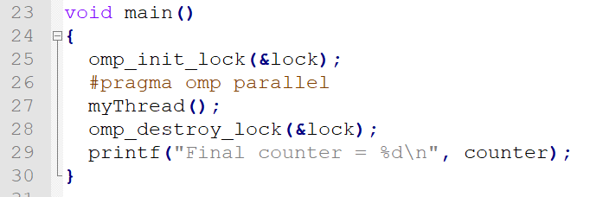
OpenMP Equivalent

Slide 14
End of week 7 Tutorial

